Slide 1
Natural Language
Processing
STEP Summer School
2026

Slide 2
What is Natural Language Processing?
Converting text into something a computer can understand
Why?
  Autocomplete
  Text classification
  Translation
  LLMs (chatbots)

Slide 3



Use Case: Text Classification

Slide 4
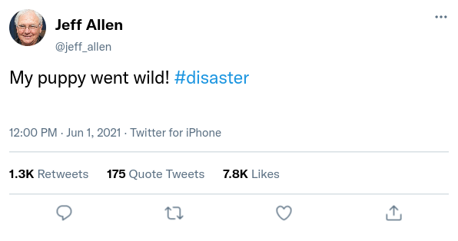
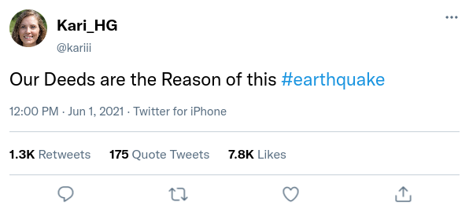

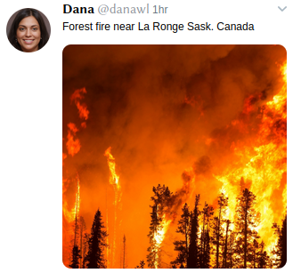
Use Case: Text Classification

Slide 5
Use Case: Entity Recognition

Slide 6
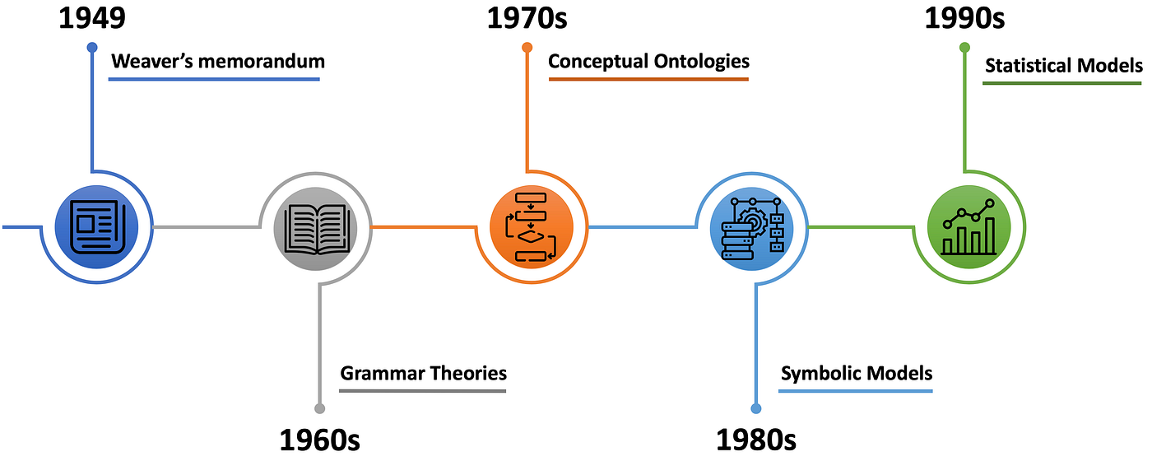
NLP: A Brief History
Source: https://medium.com/@antoine.louis/a-brief-history-of-natural-language-processing-part-1-ffbcb937ebce
Notes:
WM: machine translation, proposed 4 ideas, some of which we still use today. Some not necessarily hold true though: relatively few words have double meaning!
Next three can be boiled down to different types of rule-based methods.
Statistical/probabilistic methods are what is still popular today

Slide 7

Solve these sums…
3 + 5 =
(5 + 5) * 2 =
$\int_{1}^{2}{2x dx}$ =

Slide 8
Finish the sentences…
The cat sat on the…
I left my umbrella at…
I go back to work on…

Slide 9
Finish the sentences…
The cat sat on the mat. (box, floor, table…)
I left my umbrella at home. (work, school, the…)
I go back to work on Monday. (Tuesday, Wednesday…)
Notes:
Lots of possible answers, some more “likely” than others. No one likely says I left my umbrella at giraffe!

Slide 10
Problem: sentences have multiple correct endings

Slide 11
Problem: computers like numbers, and need algorithms
Notes:
How can we convert words, and their meaning, to numbers for a computer to understand?

Slide 12
Film Reviews
We’re going to classify film reviews into positive and negative groups.

Slide 13
Film Reviews
We’re going to classify film reviews into positive and negative groups.
A brilliant film, the acting was superb and I loved it.
A boring, lazy film. Don’t bother watching it!
Great acting, but the story was awful.

Slide 14
Film Reviews
We’re going to classify film reviews into positive and negative groups.
A brilliant film, the acting was superb and I loved it. Positive.
A boring, lazy film. Don’t bother watching it!
Great acting, but the story was awful.

Slide 15
Film Reviews
We’re going to classify film reviews into positive and negative groups.
A brilliant film, the acting was superb and I loved it. Positive.
A boring, lazy film. Don’t bother watching it! Negative.
Great acting, but the story was awful.

Slide 16
Film Reviews
We’re going to classify film reviews into positive and negative groups.
A brilliant film, the acting was superb and I loved it. Positive.
A boring, lazy film. Don’t bother watching it! Negative
Great acting, but the story was awful. Both?
Notes:
How did you know which category each was in? How would you teach someone to do this task?

Slide 17
Bag of Words
A simple technique
  group words by meaning
  count occurrence of words in each group
For our film review task:
  Positive words, negative words
  For each sentence, find the group that occurs the most

Slide 18
Bag of Words
How do we make our lists of positive and negative words?
We need training data: examples we can collect these words from
Then we test our technique on validation data: to see how well it works on unseen data

Slide 19
Bag of words
You’ve been given a list of 14 short film reviews. Follow these steps to try to classify them into positive and negative classes:
Read each review and build two lists: positive words and negative words
  Words like “and”, “I” can be ignored.
Then, for each review, count the number of positive vs. negative words
  Most words in each review “wins”
What problems do you come across?

Slide 20
Bag of Words
Positive words | Negative words
brilliant, superb, loved | boring, lazy, terrible, awful
funny, clever, best | dull, bored
wonderful | poor, dreadful
perfect | disappointing, forgettable
great
brilliant

Slide 21
Bag of Words
# | Review | Your verdict
1 | A brilliant film. The acting was superb and I loved every minute. | P
2 | Funny, clever and beautifully shot. One of the best I've seen this year. | P
3 | A boring, lazy film. The plot was terrible and the acting was awful. | N
4 | Dull and predictable. I was bored the whole way through. | N
5 | Wonderful performances and a heartwarming story. Highly recommend. | P
6 | A complete waste of time. Weak story, poor acting, dreadful ending. | N
7 | Gripping from start to finish. The ending was perfect. | P
8 | Disappointing and forgettable. Nothing about it worked. | N
9 | Great acting, but the story was a mess. | P
10 | The first half was brilliant; the second half fell apart. | P
11 | This was not good at all. | P
12 | Not bad, actually — I enjoyed it more than I expected. | N
13 | Oh great, another two hours I'll never get back. | P
14 | Far from boring. | N

Slide 22
Problem: computers like numbers!
Solution: use word counts?
Notes:
How can we convert words, and their meaning, to numbers for a computer to understand?

Slide 23
Bag of Words
# | Review | Your verdict
1 | A brilliant film. The acting was superb and I loved every minute. | P
2 | Funny, clever and beautifully shot. One of the best I've seen this year. | P
3 | A boring, lazy film. The plot was terrible and the acting was awful. | N
4 | Dull and predictable. I was bored the whole way through. | N
5 | Wonderful performances and a heartwarming story. Highly recommend. | P
6 | A complete waste of time. Weak story, poor acting, dreadful ending. | N
7 | Gripping from start to finish. The ending was perfect. | P
8 | Disappointing and forgettable. Nothing about it worked. | N
9 | Great acting, but the story was a mess. | P
10 | The first half was brilliant; the second half fell apart. | P
11 | This was not good at all. | P
12 | Not bad, actually — I enjoyed it more than I expected. | N
13 | Oh great, another two hours I'll never get back. | P
14 | Far from boring. | N

Slide 24
Bag of Words
Not clear cut
  What happens when counts are equal?
Words can have multiple meanings
  Context matters
Not sustainable for every word in a language!

Slide 25
Word Embeddings
Can we map words to a co-ordinate, so similar words are near each other?

Slide 26
Word Embeddings
https://projector.tensorflow.org
TensorFlow Embedding Projector
  Look at how words are connected.
  Search a word: what are its nearest neighbours?
  Can you find a word where its neighbours surprise you?
  Where does apple sit?

Slide 27
Word Embeddings - Examples
University – nearest neighbours are college, school. But also places, like Harvard and Cambridge – more American places than elsewhere.
Good – nearest neighbour is bad! Does this make sense?
Apple – all of its nearest neighbours are tech-related, with no fruit at all!
Notes:
This particular embedding was trained on articles sources from Google News

Slide 28
Word Embeddings: How are they generated?
We want an automated way to generate co-ordinates, given a word
Just like with Bag of Words, we need training data.
But, what is the ground truth? How do we know where we should map a word to?

Slide 29
Word Embeddings: How are they generated?
We want an automated way to generate co-ordinates, given a word
Just like with Bag of Words, we need training data.
But, what is the ground truth? How do we know where we should map a word to?
Answer: use sentence structure, and let the computer decide!

Slide 30
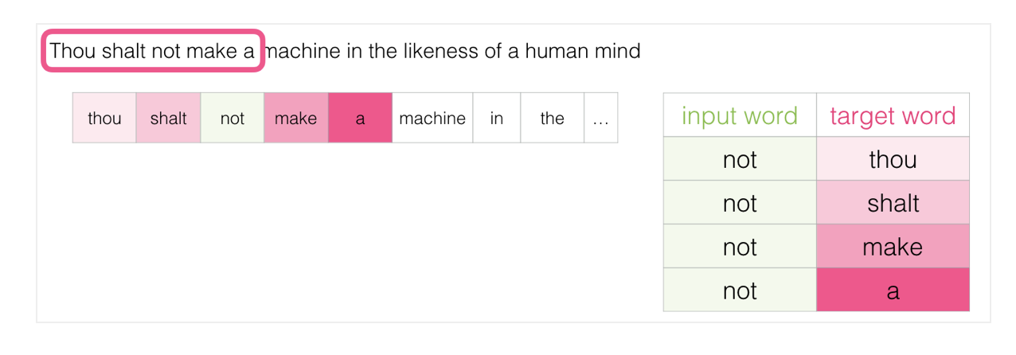
Word Embeddings: How are they generated?
We want each word to be mapped to a vector
Should ideally capture the word’s meaning
  Definitions, context, relationships
Image source: https://jalammar.github.io/illustrated-word2vec/

Slide 31
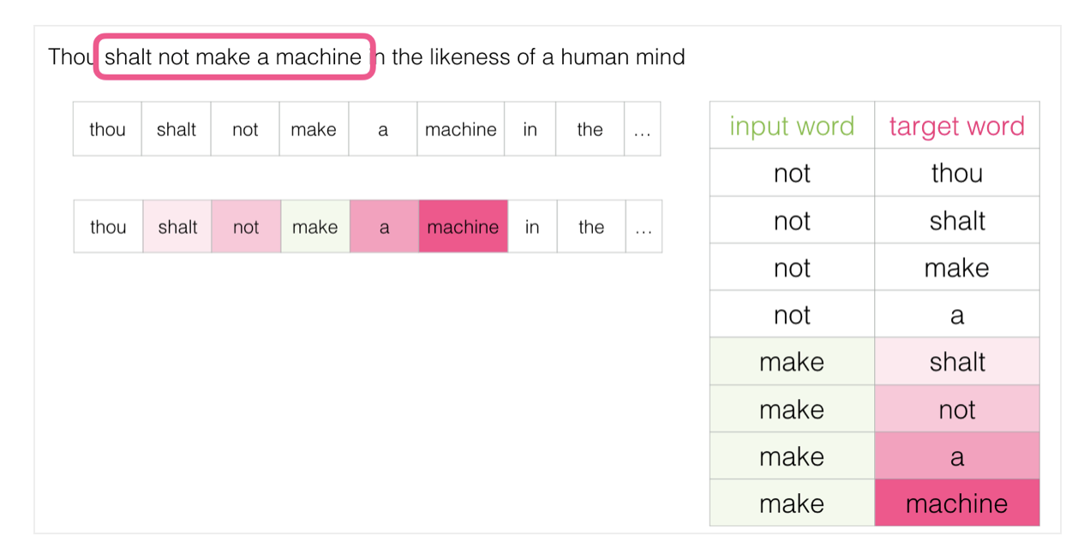
Word Embeddings: How are they generated?
Image source: https://jalammar.github.io/illustrated-word2vec/

Slide 32
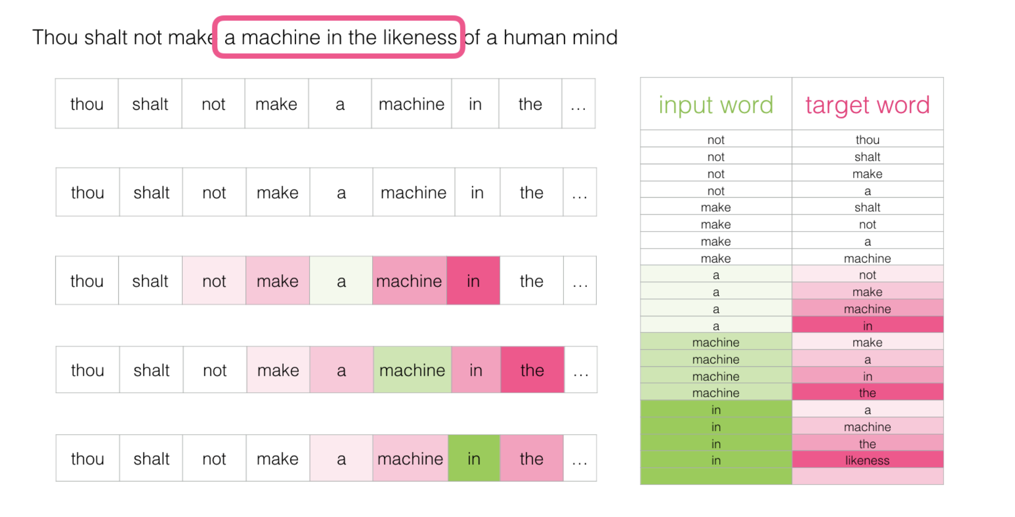
Word Embeddings: How are they generated?
Image source: https://jalammar.github.io/illustrated-word2vec/

Slide 33
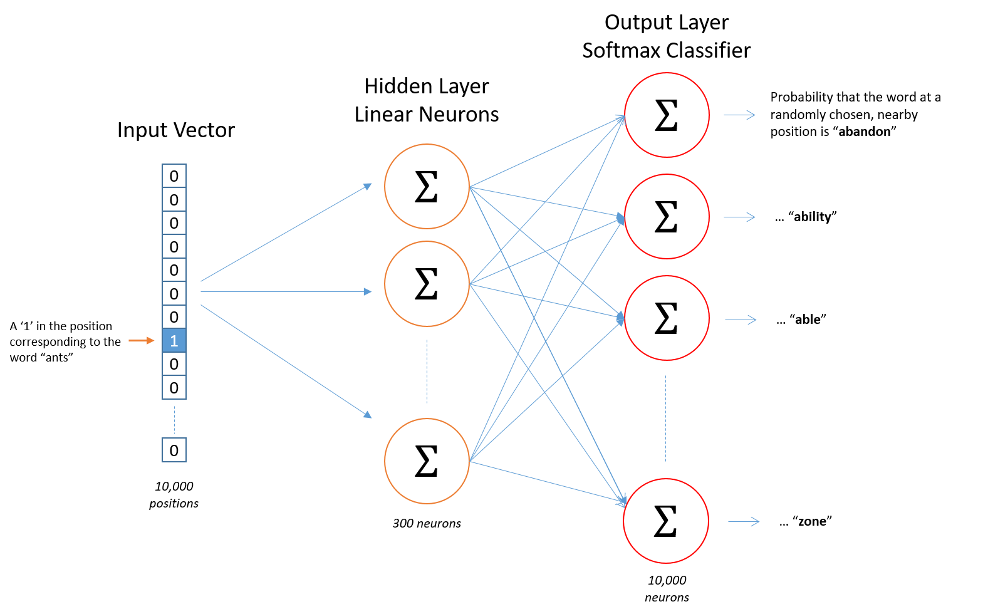
Word Embeddings: How are they generated?
Image source: http://mccormickml.com/2016/04/19/word2vec-tutorial-the-skip-gram-model/

Slide 34
Trying the “meaning” model
https://github.com/mattswatson/step-nlp-workshop
Open the first notebook and run through it – follow the instructions
  Does the meaning model do better, worse, or the same?
  Can you find reviews where the two models disagree?
  Change one word at a time – how does the verdict change?
  Try editing the example lists – can you make it better?

Slide 35
Setting up the notebook
https://github.com/mattswatson/step-nlp-workshop
Click the green Code button
  Download ZIP
  Extract the ZIP file
Linux: Double click to open in Jupyter notebook
Windows: AppsAnywhere, open both Anaconda and Visual Studio Code
  Open the folder in Visual Studio Code

Slide 36
Transformers
Specific type of neural network specifically designed for text
Uses attention: which other parts of the sentence does a word refer to?

Slide 37
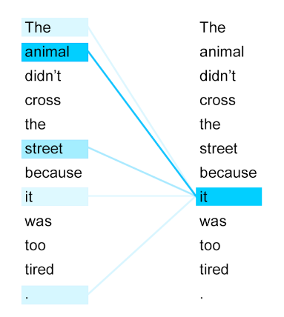
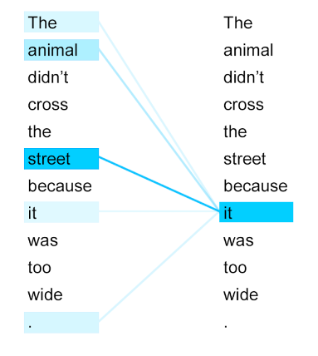
Transformers

Slide 38
Transformers
As part of the training process, transformers use attention to create their own word embeddings
These can then be used for a variety of tasks
  Classification
  Next word prediction
  Named entity recognition

Slide 39
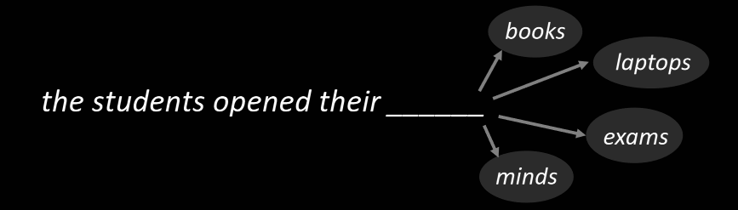
Why have transformers become so popular?

Slide 40
Model Training
You saw a very simple version of model training
This is only one way we can approach this task
A big benefit of transformers and LLMs is we can treat many tasks as next word prediction

Slide 41
Task: build a next-word generator
Open the second notebook – you’ll turn text into numbers, then build a model that writes new text.
Paste in your own text (lyrics, a story…) and see how the model’s “voice” changes.
Change how many previous words it looks at – what makes it more coherent, or funnier?

Slide 42
Large Language Models
Transformers are the basis for today’s large language models
  The T in GPT
LLMs have been trained on (very) large text corpora
  This makes them very good at a lot of tasks
But often not without good prompting!

Slide 43
Model Training
Input:
Here is some text: “I thought the film was brilliant!”
Is this a positive or negative review? Answer with one word only:
Output:
positive

Slide 44
Zero Shot Prompting
Prompt:
Classify the text as positive or negative.
Text: I think the STEP summer school is amazing.
Sentiment:
Output:
positive

Slide 45
Few Shot Prompting
Prompt:
Classify the text as positive or negative.
Text: I hate Google Colab because it doesn’t let me use GPUs.
Sentiment: negative
Text: I think STEP summer school is amazing.
Sentiment:
Output:
positive

Slide 46
Prompting Guides
LLMs typically perform better with structured prompts
For new tasks, or with smaller models, few shot prompting is usually best
https://www.promptingguide.ai

Slide 47
Optional: try prompting in the browser
If there’s time, open any free chatbot in a browser
  Claude, ChatGPT, Copilot
Try the zero-shot and few-shot prompts from the last slides, for the review classification task. Does the format of the prompt change the answer?
LLMs usually do better with structured prompts – for tricky tasks, few-shot is often best.
promptingguide.ai

